Slide 1
Coca-Cola: Pioneering the Future Through AI
How AI is Reshaping the Soft Drink Industry

Slide 2
SITUATION
STATEMENT
“Big data and AI power everything that the business does and is the foundation for everything we do. We create intelligent experiences. AI is the kernel that powers that experience”
- Greg Chambers (Global Director of Digital Innovation)
Status quo
Marketing soft drinks around the world is not a “one-size-fits-all affair” with >500 Coca-Cola products being sold in >200 countries
problem
In each of these markets there are local differences concerning flavours, sugar and calorie contents, marketing preferences and competitors faced by the brand
Plan of action
Collect and analyse huge amounts of data from disparate sources to determine which of the >500 brands are likely to be well received, with the taste of most well-known brands differ from country to country
Notes:
https://www.artificialintelligence-news.com/2019/05/07/how-coca-cola-is-using-ai-to-stay-at-the-top-of-the-soft-drinks-market/

Slide 3
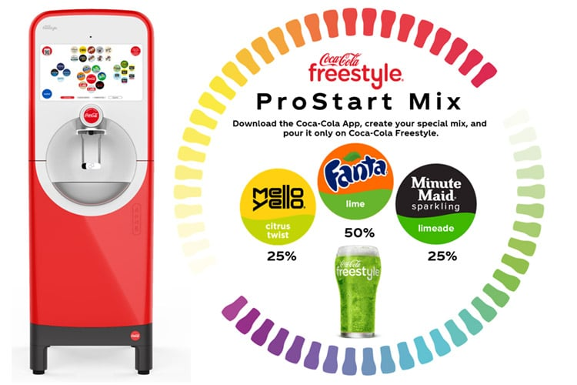
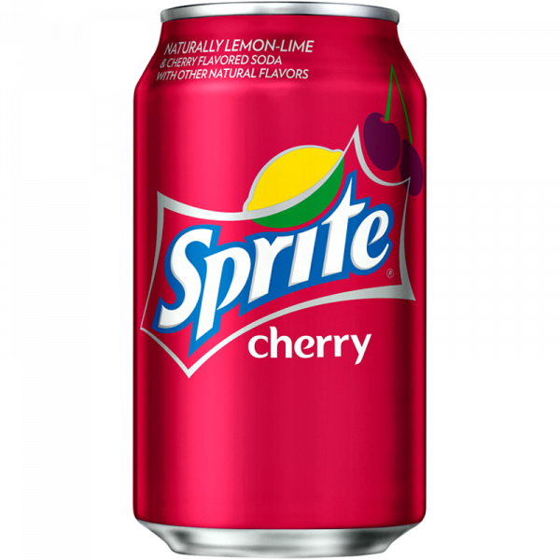
Use-case #1: AI for Customer Preference Understanding and Product Development
Coca-Cola Freestyle
“In order to use the mobile app, consumers need to register with their social media account. Coca-Cola uses AI to analyse the social media content of their consumers, generating insights on where, when and how its products are consumed. Based on the consumer behaviour and demographics analysis, Coca-Cola can identify which products are popular in which areas.”
- Chris Hellmann (GM of Coca-Cola Freestyle)
Notes:
https://www.artificialintelligence-news.com/2019/05/07/how-coca-cola-is-using-ai-to-stay-at-the-top-of-the-soft-drinks-market/
50k units / 14m beverages a day (in 2018)

Slide 4
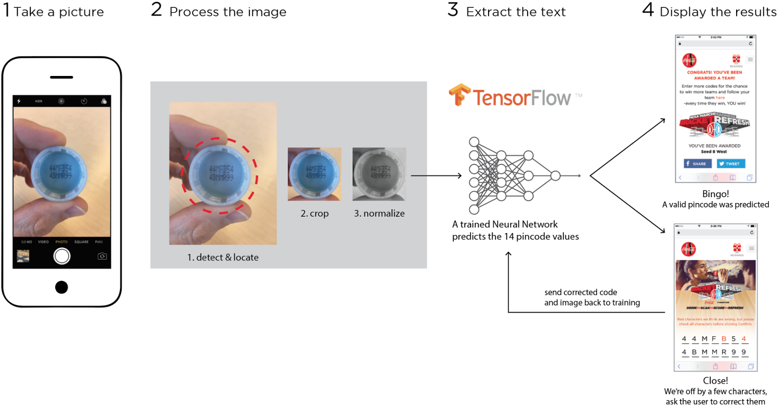
Use-case #2: OCR for Customer Rewards Experience
TensorFlow Machine Learning
“We created a purpose-built training app for iOS and Android devices that ‘trainers’ could use to take pictures of codes and label them; these labeled images were then transferred to cloud storage for training. We then distributed these to multiple suppliers who used the app to create the initial real-world training set.”
- Patrick Brandt (Senior Solutions Strategist)
Notes:
https://emerj.com/ai-sector-overviews/artificial-intelligence-at-coca-cola/

Slide 5
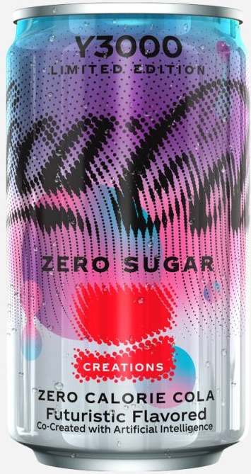
Coca-Cola Y3000 THE AI-CRAFTED BEVERAGE
A Futuristic Taste Odyssey
The Future of Engaging Beverage Experiences
AI-Crafted Flavours
Y2K Aesthetic Packaging
Limited
Interactive Video Journey
Fashion Meets Flavour
Beyond the beverage

Slide 6
DISCUSSION
Ethical Considerations in AI Deployment:
As Coca-Cola utilises AI to analyse vast amounts of data from social media and other platforms, what ethical considerations should be taken into account to ensure customer privacy and data security?
Long-term Impact on Human Creativity:
With the increasing reliance on AI for creative processes such as flavour development and advertising content creation, could there be potential negative impacts on human creativity and job opportunities in the industry? How can a balance be maintained to foster both technological innovation and human talent?

Slide 7
THANK YOU

